Slide 1
Euro Leagues Soccer Outcome Prediction
Luca Petrelli, Ph.D.

Slide 2
Outline
Problem Description
Data
Data Exploration
Features
Classifiers
Log Loss and Accuracy Evaluation
Probability Calibration
Return On Investment
Conclusion
Recommendations

Slide 3
Problem Description
Predicting soccer outcomes for games in the 5 major European leagues. Setting probabilities of Home win, Draw, or Away win. Predicting games outcomes is a difficult process, and bookmakers would like to improve their predictions.
Goal: improve on current bookmakers’ odds assignment. Deliver a model that does better, not only in terms of accuracy but also in terms of actual returns for the bookmakers.

Slide 4
Data
Data is taken from the European Soccer Database at:
https://www.kaggle.com/hugomathien/soccer
8 seasons of soccer statistics from 11 European Leagues, 4 tables:
Player: names, birthdates
Player_Stats: FIFA games attributes
Team: short and long names, team_ids
Match: game scores, dates, in-game events, bookmakers’ odds

Slide 5
Data Exploration
Bookmakers’ Accuracy
Home Advantage
Individual Team Performance
Goals

Slide 6
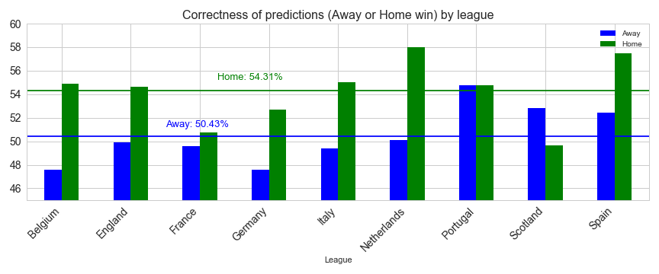
Bookmakers Accuracy

Slide 7
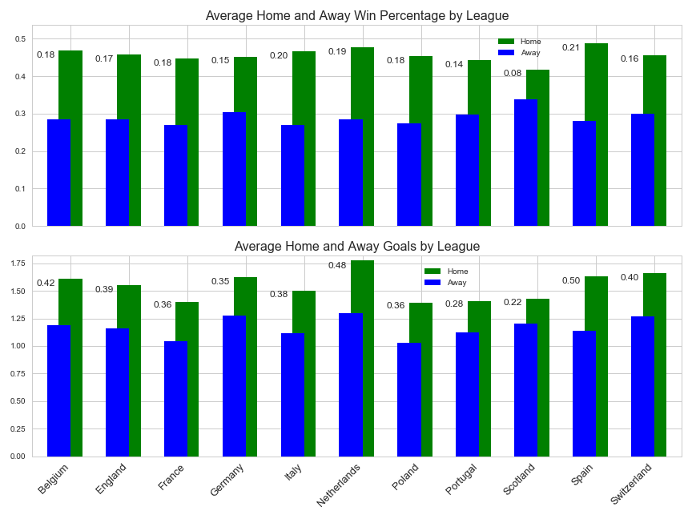
Home Advantage

Slide 8
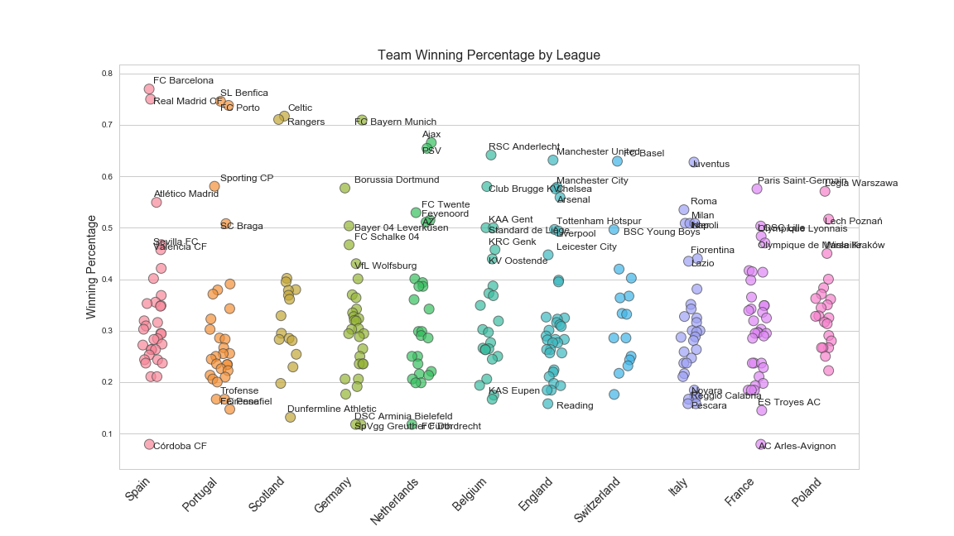
Team Performance

Slide 9
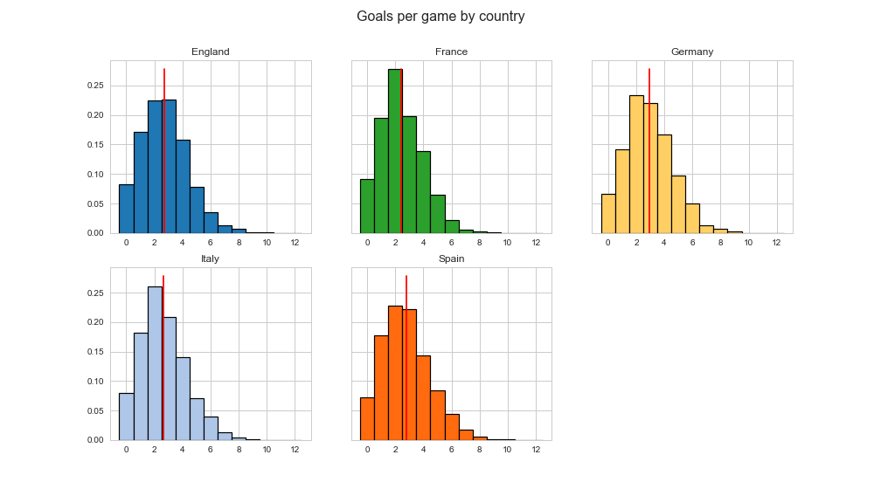
Goals

Slide 10
Features
Bookmakers’s odds: 2 days before game
Points: average points during current season
Streak: average points of last 5 games
Formation: defensive, offensive (binary)
League and stage: (categorical) and (numerical)
Overall rating: team average rating from FIFA game
Best player: rating of best player in team
Diff: absolute value of difference between max and min odds
Tie: score on 5 most likely criteria to identify tie games (0 to 5)

Slide 11
Classifiers
LR = LogisticRegression(C=.01, solver='sag', random_state=r, multi_class='multinomial')
RF = RandomForestClassifier(n_estimators=200, max_depth=8, min_samples_leaf=6, min_samples_split=20, random_state = r, max_features='sqrt')
ABRF = AdaBoostClassifier(
base_estimator=RandomForestClassifier(n_estimators=30, max_depth=6, min_samples_leaf=3, min_samples_split=10, random_state=r, max_features='sqrt'), n_estimators=15, learning_rate=.35)

Slide 12
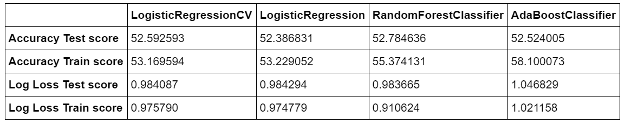
Log Loss and Accuracy Evaluation
Bookmakers’ Accuracy: 52.73 (on test set)

Slide 13
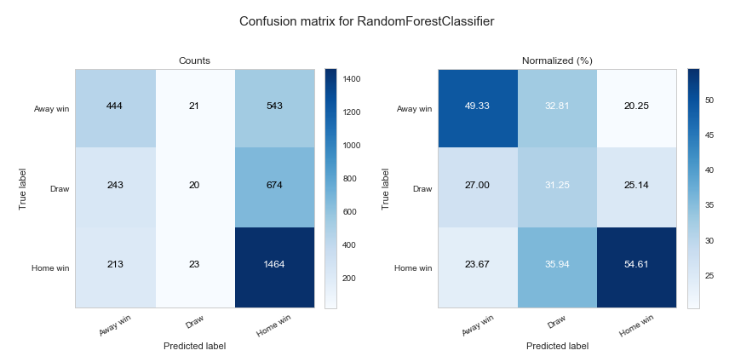
Log Loss and Accuracy Evaluation

Slide 14
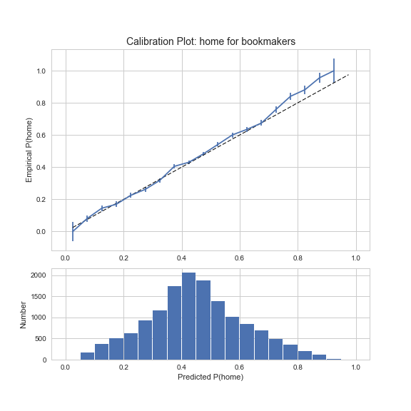
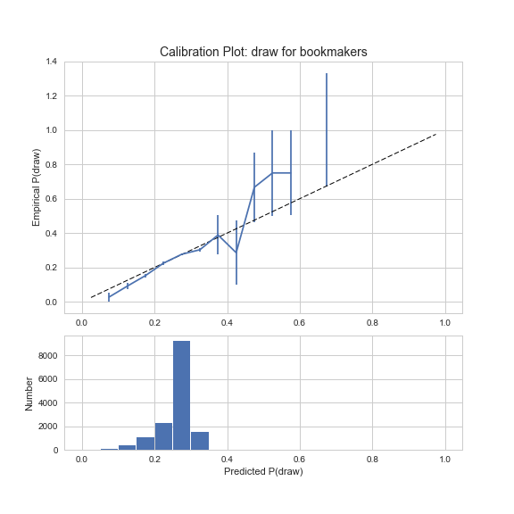
Probability Calibration

Slide 15
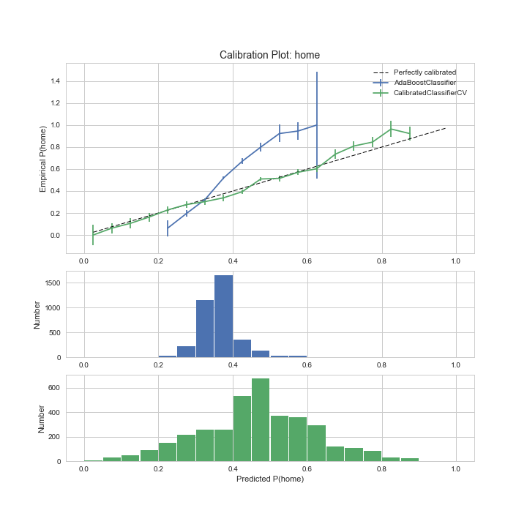
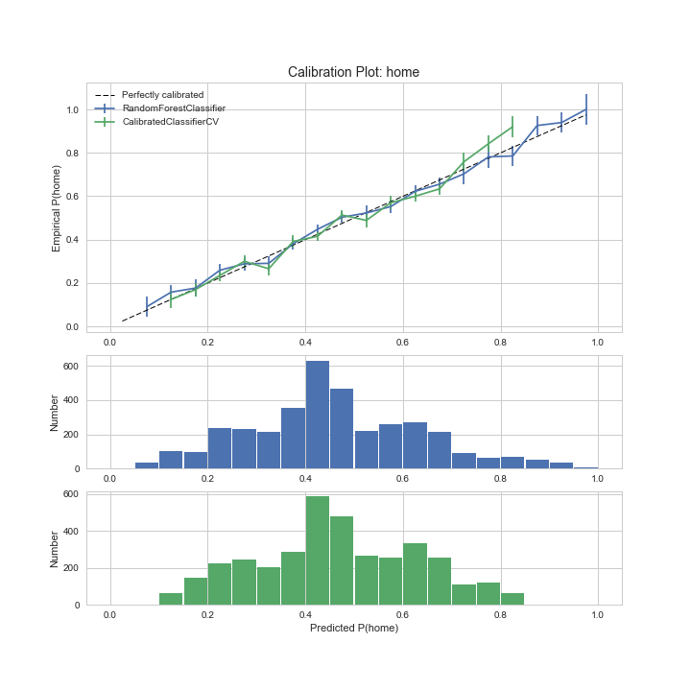
Probability Calibration

Slide 16
Return On Investment (ROI)
Assumptions
Bookmakers’ and Model impose same commission (6.11%)
Bet amounts are balanced: same payout regardless of outcome
Comparison
Bet amount is average of balanced amounts for bookmakers and model
ROI includes any commission

Slide 17
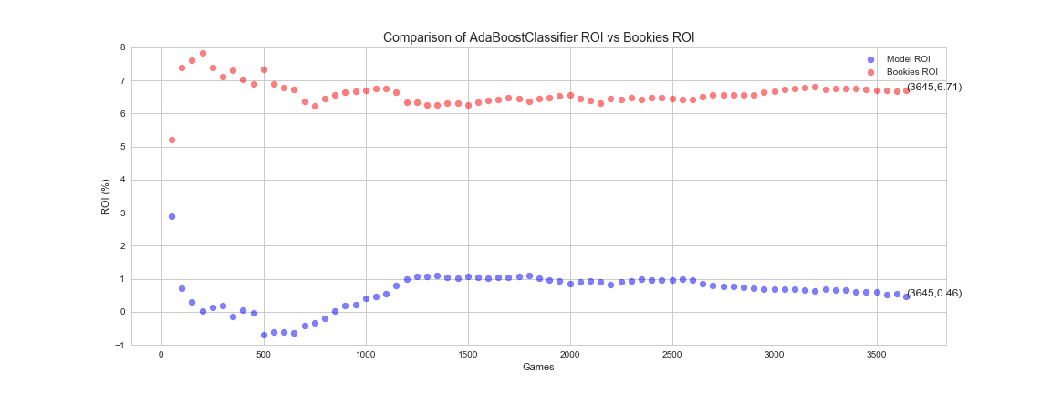
Return On Investment (ROI) ADABoost (not calibrated) w/ RF

Slide 18
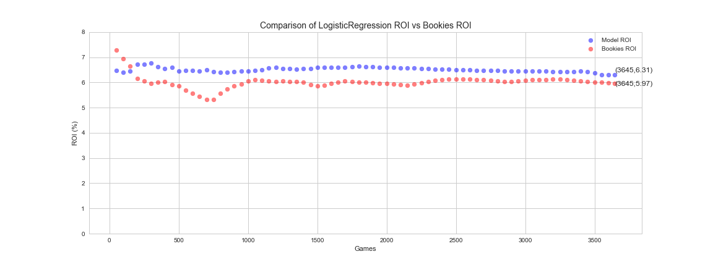
Return On Investment (ROI) LogisticRegression (not calibrated)

Slide 19
Conclusions
Best Classifier(s): LinearRegression and/or RandomForest
Model vs Bookies:
Accuracy: 52.78% vs 52.73%
ROI: 6.34% vs 6.03%

Slide 20
Recommendations
Use LogisticRegression or RandomForest, without calibration, and/or boosting.
Do not use Accuracy score to evaluate probabilities, log loss or ROI are preferred.
Make sure classifiers are well calibrated on extreme probabilities.
Determine better features than player attributes from FIFA games. Use real game statistics.

